Slide 1

Networks
Yr12 applications

Slide 2
Contents
Lesson 1: Network Basics
Lesson 2: Network Vocabulary
Lesson 3: Types of Graphs (Planar, trees, bipartite etc)
Lesson 4: Adjacency Matrices
Lesson 5: Eulerian
Lesson 6: Hamiltonian
Lesson 7: Shortest Paths

Slide 3
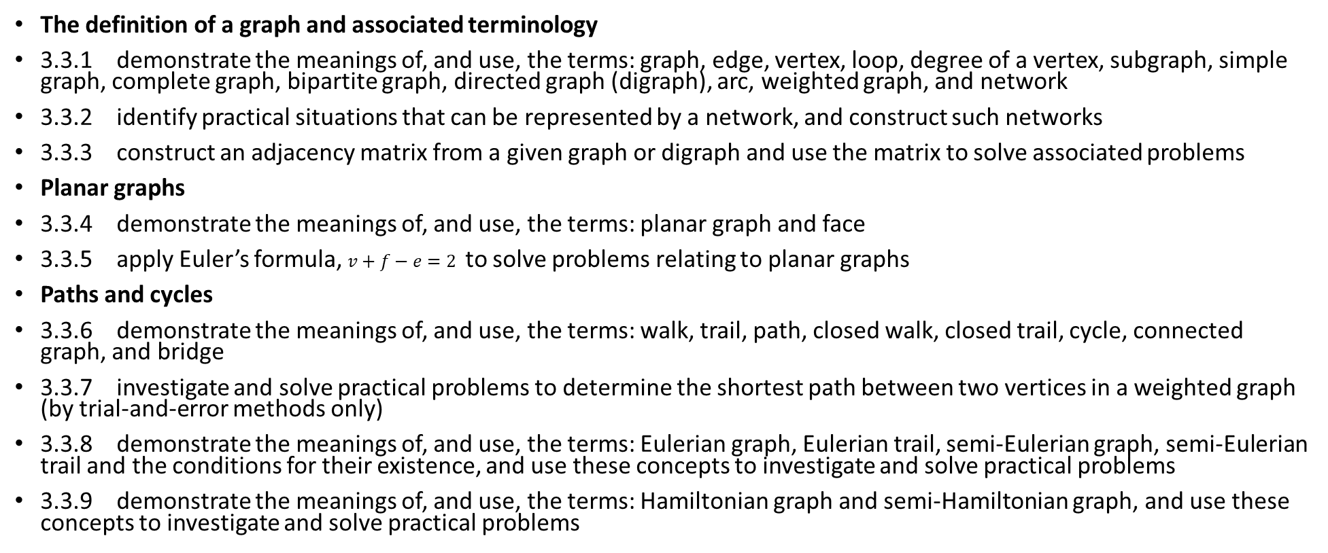
Syllabus
The definition of a graph and associated terminology
3.3.1 demonstrate the meanings of, and use, the terms: graph, edge, vertex, loop, degree of a vertex, subgraph, simple graph, complete graph, bipartite graph, directed graph (digraph), arc, weighted graph, and network
3.3.2 identify practical situations that can be represented by a network, and construct such networks
3.3.3 construct an adjacency matrix from a given graph or digraph and use the matrix to solve associated problems
Planar graphs
3.3.4 demonstrate the meanings of, and use, the terms: planar graph and face
3.3.5 apply Euler’s formula, $v+f−e=2$ to solve problems relating to planar graphs
Paths and cycles
3.3.6 demonstrate the meanings of, and use, the terms: walk, trail, path, closed walk, closed trail, cycle, connected graph, and bridge
3.3.7 investigate and solve practical problems to determine the shortest path between two vertices in a weighted graph (by trial-and-error methods only)
3.3.8 demonstrate the meanings of, and use, the terms: Eulerian graph, Eulerian trail, semi-Eulerian graph, semi-Eulerian trail and the conditions for their existence, and use these concepts to investigate and solve practical problems
3.3.9 demonstrate the meanings of, and use, the terms: Hamiltonian graph and semi-Hamiltonian graph, and use these concepts to investigate and solve practical problems

Slide 4
Lesson 1
Contents
Topic: Network basics
EQ: What are networks?

Slide 5
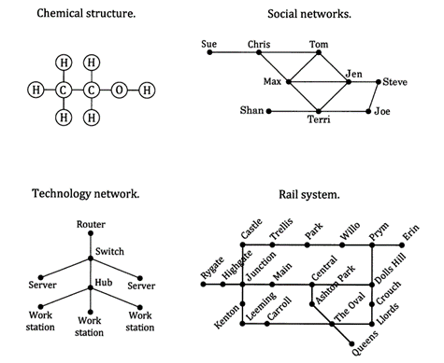
Networks in real life
Networks are a graphical way of representing information that is connected.

Slide 6



Topic: Network basics
EQ: What are networks?
Vertices (sing: vertex) or nodes
Edges
Faces or Regions
Junctions and end points
Connections
Separated areas:

Slide 7
Complete Exercise 5A

Slide 8
Lesson 2
Contents
Topic: Network Vocabulary
EQ: What are key words you need to know about networks?

Slide 9
24
7
30
Date
Networks
What are key words you need to know about networks?
Graph Theory
What is a graph?
What is a loop?
What are multiple edges?
What is a weighted graph/network?
What are directed edges/arcs?
What is a simple graph / simple network?
The study of networks
A diagram with vertices and edges.
An edge that starts and finishes at the same vertex.
Two or more edges that connect the same two vertices.
Edges that are ‘worth’ different amounts (distance, cost, time etc).
Edges with directions given
Graphs without directed edges are call undirected graphs, graphs with directed edges are call directed graphs.
An undirected, unweighted graph with no loops or multiple edges.

Slide 10
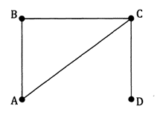
24
7
30
Date
Networks
What are key words you need to know about networks?
What is a walk?
Closed walk
Open walk
Length
Connected vertices
Adjacent vertices.
Any path on a network from one vertex to another
e.g.
A walk that starts and finishes at the same vertex e.g. ABCA
A walk that ends at a different vertex e.g. ABCD
*a walk can repeat edges e.g. ACBCD
The number of edges used in the walk.
If it is possible to get from one vertex to another along several edges.
If the vertices are connected by only one edge.
ACD and ABCD are ‘walks’ from A to D

Slide 11
24
7
30
Date
Networks
What are key words you need to know about networks?
What is a walk?
Trail
Path
Cycle
Connected graph
Bridge
Complete Graphs (Kn)
Any path on a network from one vertex to another
e.g.
A walk that involves no repeated edges eg CABCD
A walk that involves no repeated edges or vertices (other than perhaps the start/finish) Eg ABCD
Closed Path Eg ABCA
All vertices are connected vertices
An edge that when removed leaves the graph disconnected
Simple graphs where all vertices are joined by exactly 1 edge
ACD and ABCD are ‘walks’ from A to D

Slide 12
Complete Exercise 5B

Slide 13
Lesson 3
Contents
Topic: Types of graphs
EQ: What are the different types of networks?

Slide 14
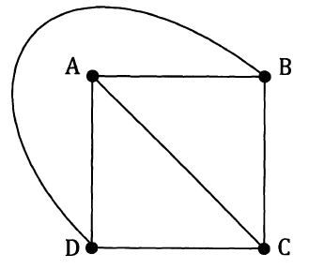
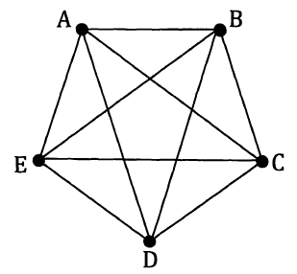
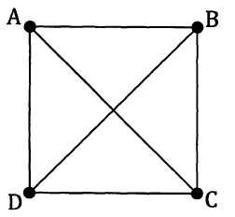
24
7
30
Date
Networks
What are the different types of networks?
Planar Graphs
A graph that can be drawn in the same plane (without its edges crossing over).
Could be drawn like this!
Not Planar
Planar!
12 + 5 ≠ 20 + 2
5 + 4 ≠ 8 + 2
4 + 4 = 6 + 2
Euler’s Rule
Euler’s Rule ( f + v = e + 2) can be used to prove if a shape has been drawn planar.

Slide 15
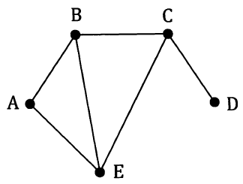
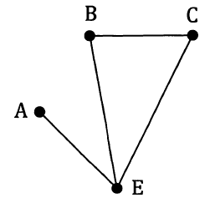
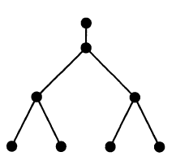
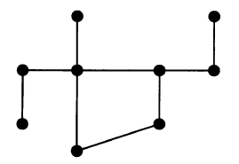
24
7
30
Date
Networks
What are the different types of networks?
Subgraphs
Part of an original graph
Original
Subgraph
Bipartite Graphs
A graph where vertices are split into 2 groups and no edges join vertices of the same group.
Trees
A connected simple graph (no loops, no multiple edges) that contains no cycles (closed paths). Every edge must be a bridge.
Note: A tree with n vertices has n-1 edges
Tree
Not a Tree (contains a cycle)

Slide 16
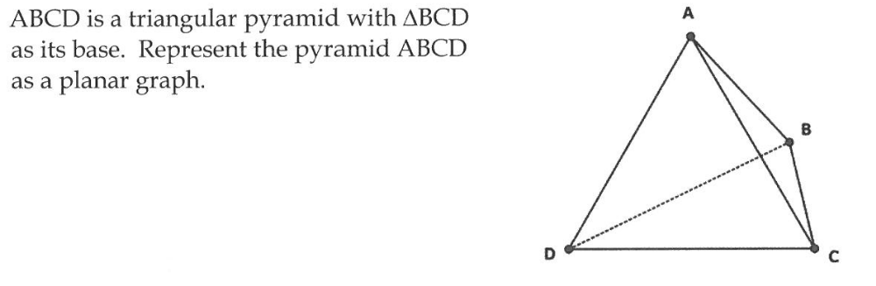
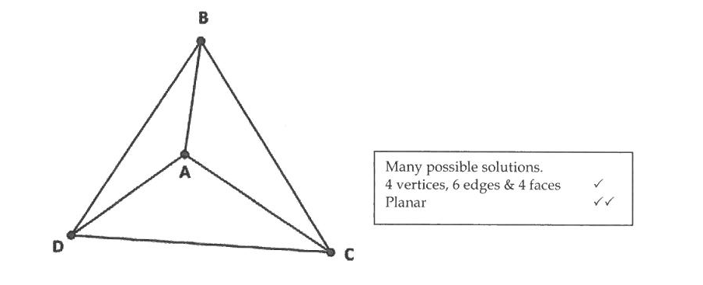

Slide 17
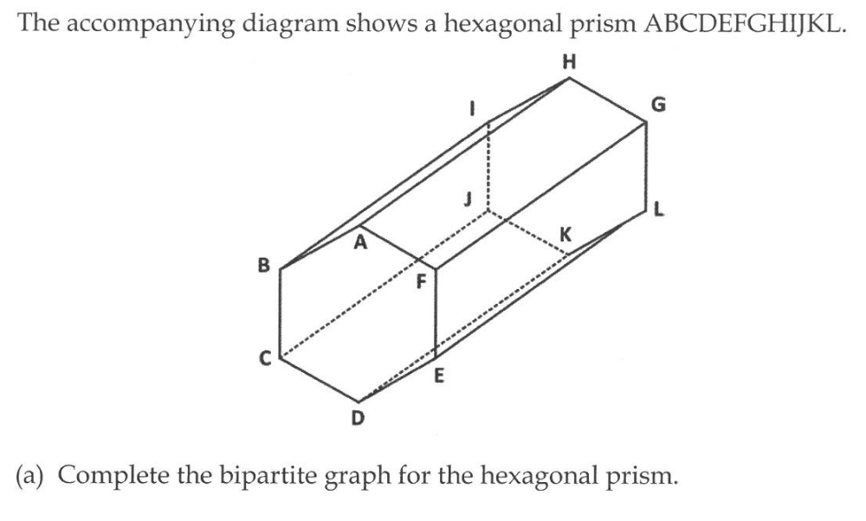
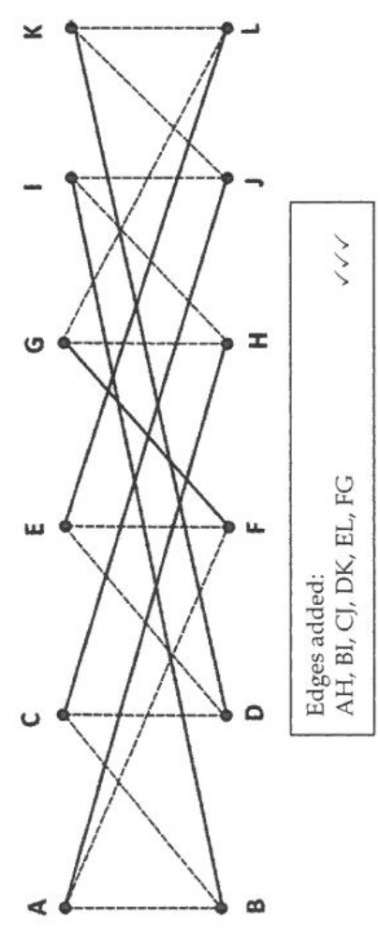

Slide 18
Complete exercise 5C please

Slide 19
Lesson 4
Contents
Topic: Adjacency Matrices
EQ: How do use adjacency matrices?

Slide 20
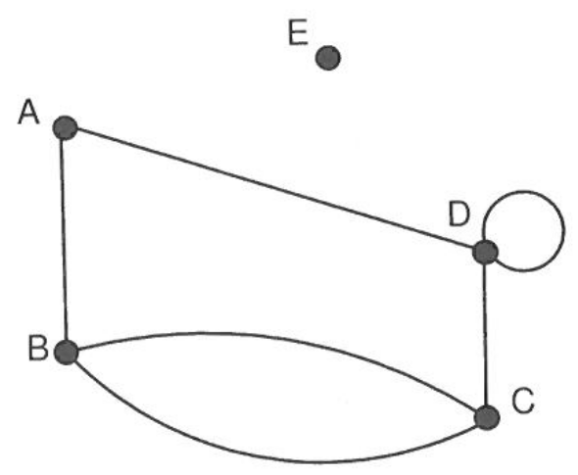
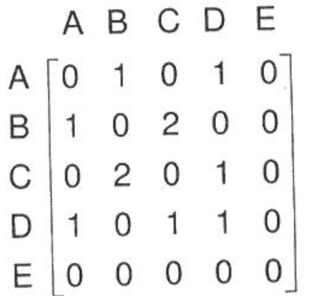
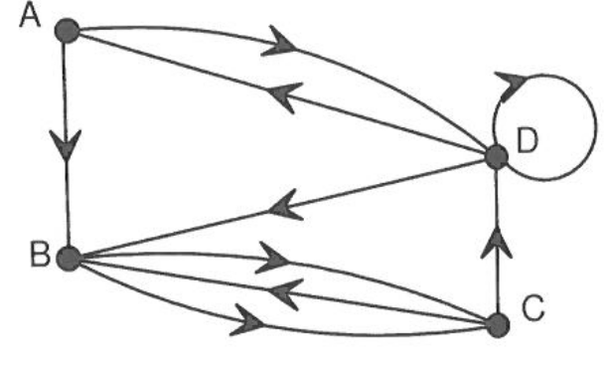
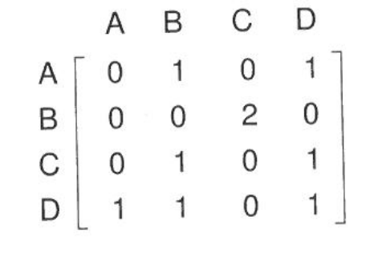
24
7
30
Date
Adjacency matrices
EQ – How do use adjacency matrices?
What is an adjacency matrix?
An adjacency matrix maps the edges that connect vertices in a network
Not directed are symmetric across the diagonal
How does it change for directed matrices?
To
From

Slide 21
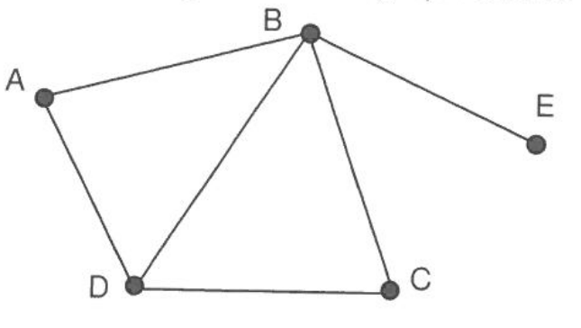
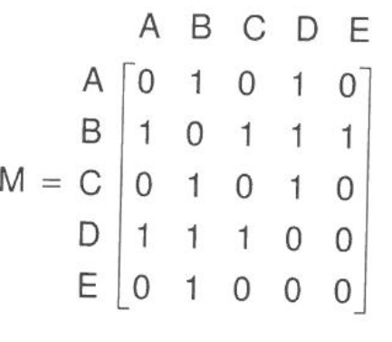
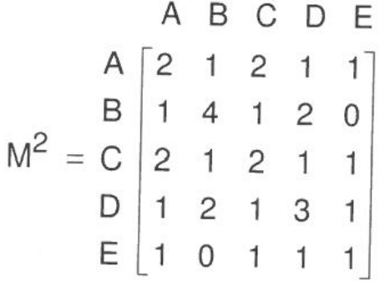
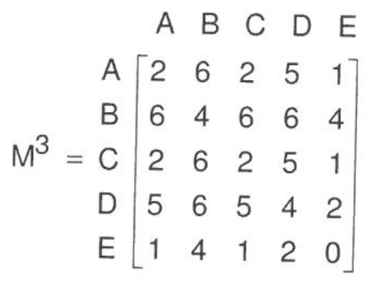
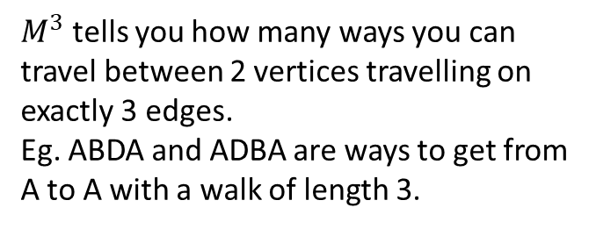
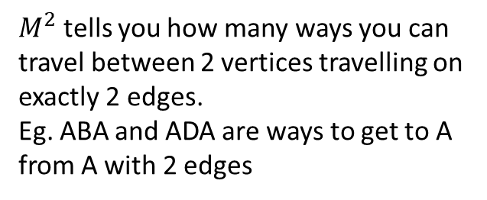
24
7
30
Date
Adjacency matrices
EQ – How do use adjacency matrices?
How can we apply adjacency matrices?
$M^{2}$ tells you how many ways you can travel between 2 vertices travelling on exactly 2 edges.
Eg. ABA and ADA are ways to get to A from A with 2 edges
$M^{3}$ tells you how many ways you can travel between 2 vertices travelling on exactly 3 edges.
Eg. ABDA and ADBA are ways to get from A to A with a walk of length 3.

Slide 22
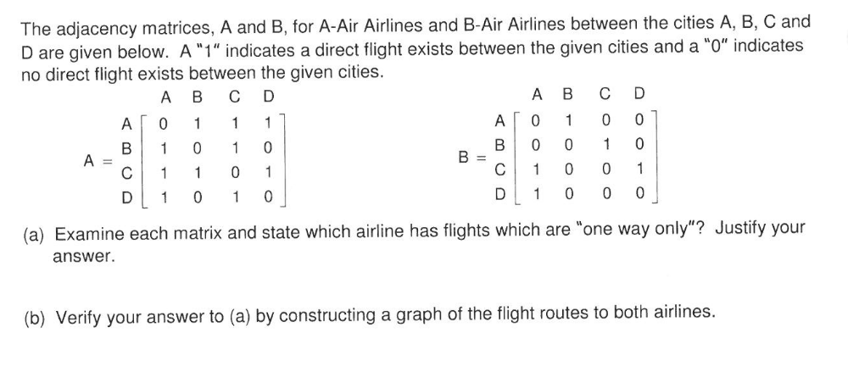
Practice Question

Slide 23
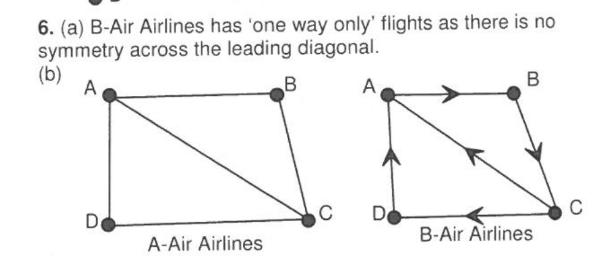

Slide 24
Complete worksheet KLUP

Slide 25
Lesson 5
Contents
Topic: Eulerian
EQ: How do you know if a network is Eulerian or not?

Slide 26


Slide 27
24
7
30
Date
Networks
EQ – How do you know if a network is Eulerian or not?
What is Euler’s rule?
*pronounced oiler
What does Traversable mean?
Traversable or not?
F + V = E + 2
*for any polyhedron that does not intersect itself
F – Faces
V – Vertices (corners)
E – Edges
Any network that can be drawn without taking the pen off the paper or going over the same edge twice.
Count the number of nodes (vertices) with an ODD number of edges joining to it.
NO odd nodes or TWO odd nodes = traversable
No odd nodes = traversable path
Two odd nodes = traversable circuit

Slide 28
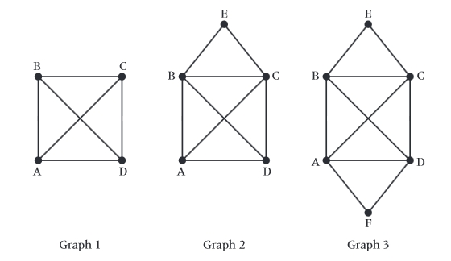
Are the following traversable?
No Yes Yes

Slide 29
24
7
30
Date
Networks
EQ – How do you know if a network is Eulerian or not?
Eulerian Trail
Eulerian Circuit
Eulerian Graph
Semi-Eulerian Trail
Semi-Eulerian Graph
An Eulerian trail is a trail in a connected network that travels every edge in the graph only once. Vertices can be repeated, but not edges
An Eulerian circuit: If an Eulerian trail is closed (trail begins and ends at the same vertex).
Eulerian Graph: A graph with a closed Eulerian circuit.
Things to check:
1. all vertices are even
2. Start and finish at the same vertex for the circuit
3. Every edge must be traversed only once
Semi-Eulerian trail; the trail is open (begins and ends at different points). It still goes on every edge exactly once.
It is a semi-Eulerain path is it has an open trail.
Things to check:
Exactly 2 odd vertices

Slide 30
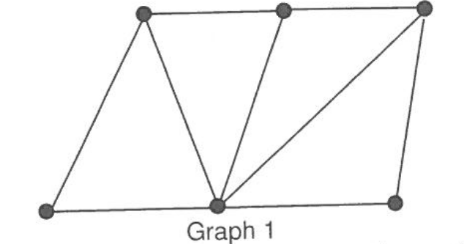
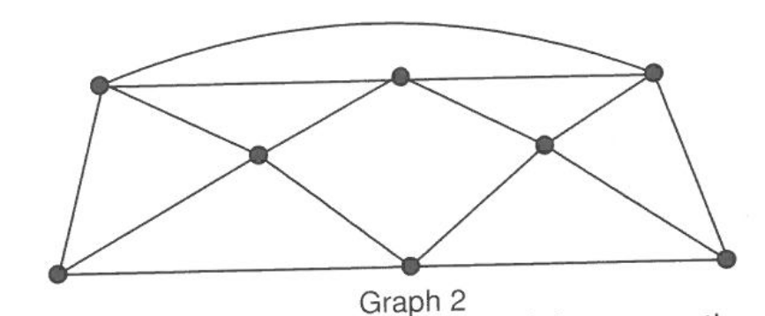
Determine whether the following are Eulerian, Semi-Eulerian or neither
Neither Semi- Eulerian
More than 2 odd vertices exactly 2 odd vertices

Slide 31
Complete KLUP exercise 8B Eulerian and Semi-Eulerian paths

Slide 32

Lesson 6
Topic: Hamiltonian
EQ: How can we tell if a network is Hamiltonian?
Contents

Slide 33
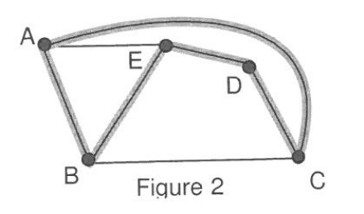
24
7
30
Date
Hamiltonian Networks
EQ: How can we tell if a network is Hamiltonian?
Hamiltonian Path
Hamiltonian Cycle
Semi-Hamiltonian graph
Properties of Hamiltonian
A Hamiltonian Path is a path in a connected graph that includes every vertex exactly once.
A Hamiltonian Cycle is a closed path that goes to each vertex exactly once. This is a Hamiltonian Graph
A semi-Hamiltonian graph is a graph that contains a Hamiltonian path, but not a cycle.
Connected graph
Any Hamiltonian cycle can be converted to a Hamiltonian path by removing one edge
A Hamiltonian path can be converted to a cycle only if the end points are connect by an edge
All complete graphs are Hamiltonian
Complete bipartite graphs which have the same number of vertices in each group are Hamiltonian

Slide 34
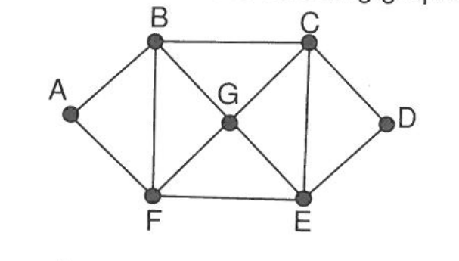
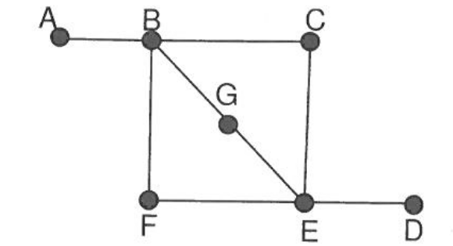
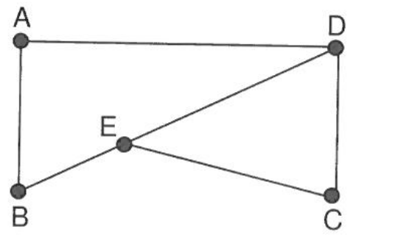
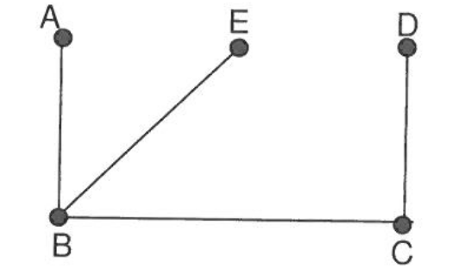
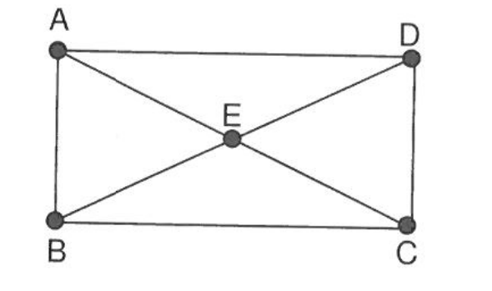
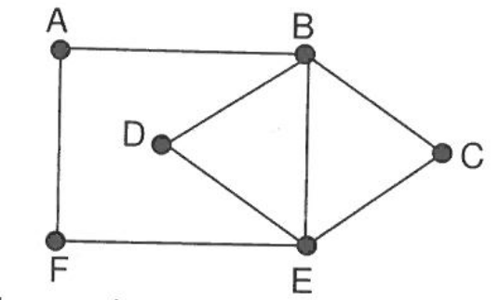
Classify the following as Eulerian, semi-Eulerian, Hamiltonian, and/or semi-Hamiltonian
Semi- Eulerian
None
Eulerian and semi-Hamiltonian
Eulerian and Hamiltonian
Semi-Eulerian and Hamiltonian
Hamiltonian

Slide 35
Please complete KLUP exercise 8C

Slide 36
Lesson 7
Contents
Topic: Shortest path
EQ: How can we work out the shortest path for a network?

Slide 37
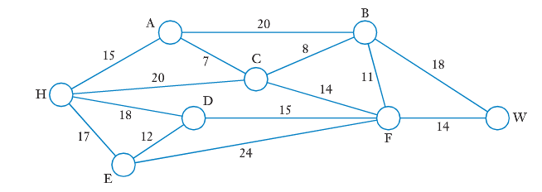
Starting problem
The diagram above shows a network of roads linking the locations of H,A,B,C,D,E,F and W, shown as circles (the circles are the vertices, not loops – the reason we are using circles will become apparent later). The number on the road (edge) is the distance between the two locations, in kms
A motorist wished to travel from home, at H, to work, at W, by the shortest route. Which route should the motorist take and how long will it be?

Slide 38
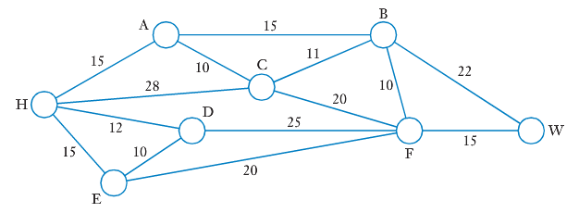
continued
After travelling by the shortest route, the motorist now realizes there may be a quicker route (road conditions, speed limits, etc...). She estimates the time it takes to travel each section of road, in minutes, shown on the diagram above.
Assuming her estimations are correct, which route should she take to complete the journey from H to W as quickly as possible, and how long will it take?

Slide 39
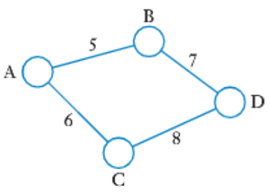
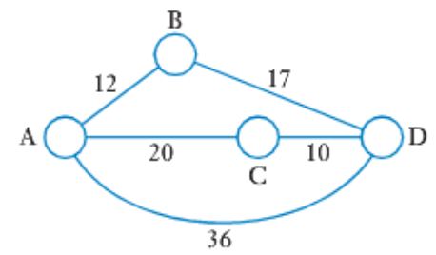
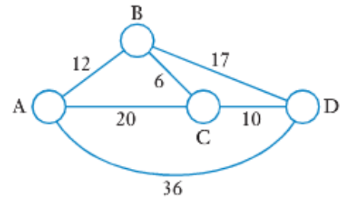
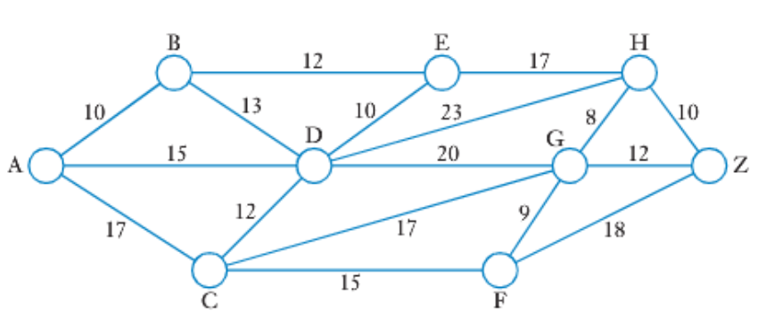
24
7
30
Date
Shortest path
EQ: How can we calculate the shortest path for a network?
Shortest path is the path to get from one vertex to another on a weighted network, where there least amount of weight is used.
In simple networks, it can be easy to spot the shortest path, as below:
For more complicated networks, simple inspection may not be so easy, as below:
For these, we will use an algorithm to help us

Slide 40
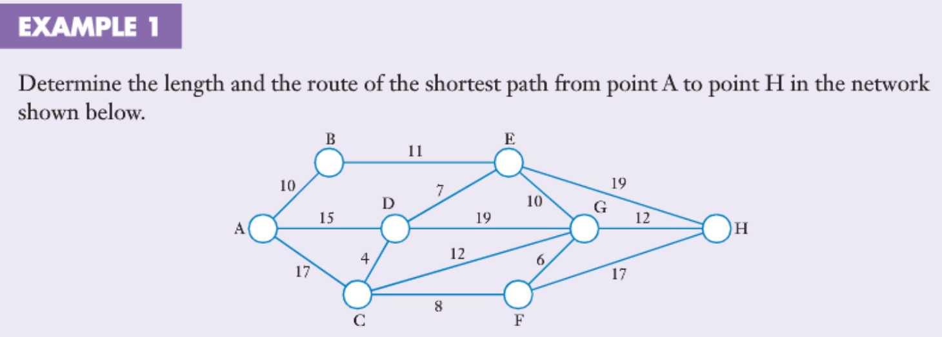
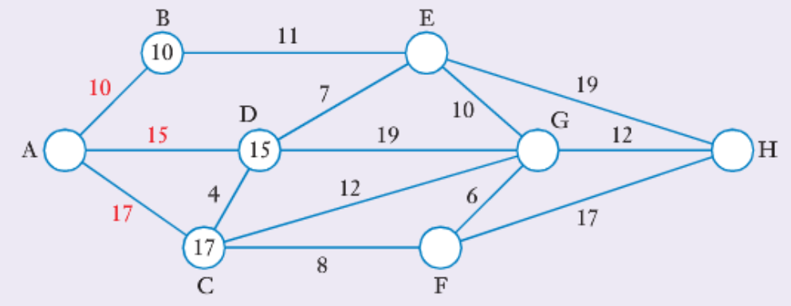
As we proceed from A to H, we will place a number at each vertex in turn, to indicate the length of the shortest path from A (or whatever starting point) to that vertex. We’ve also labelled that edge in red

Slide 41
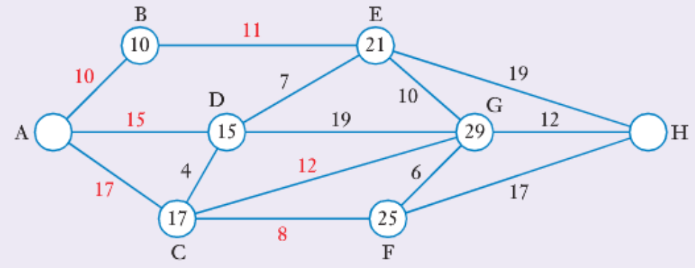
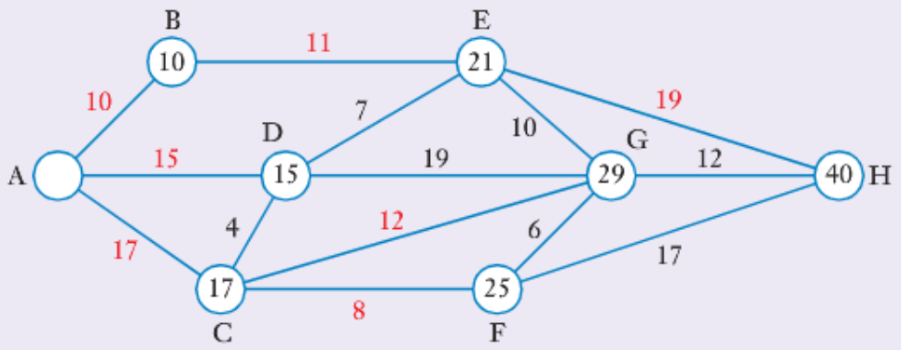
If we continue on to E,F and G, the diagram will look like this
We can then complete the method by continuing on to point H: Thus the shortest path from A to H is 40 units. By backtracking from H back to A, along red numbers only, we see that the shortest path is H-E-B-A
Thus the shortest path is 40 units and is achieved by the route ABEH

Slide 42
Please complete exercise 6A Sadler

Slide 43
Networks will return in Unit 4
Further revision
Misc 6 Sadler
Ch 12, 13 and 14 in ATF WACE revision book
Mathspace

